Slide 1
Improving CNDO/2 with Overlap for Hydrocarbon Energy Calculations
Jeremy Millford
Casey Tomlin
Notes:
Hey everyone, our project was to improve CNDO/2 with overlap to improve Hyrdocarbon modeling

Slide 2
Topic and Objective
Model | Accuracy | Computational cost | limitations
CNDO/2 | Qualitative | lowest | Limited geometry predictions
INDO | moderate | Slightly higher | Limited bond lengths
CNDO/S | Improved over CNDO/2 | Moderate | Limited bond lengths
MINDO | Best for energies and geometry | Higher | Less accurate that modern DFT
Objectives:
Expand CNDO/2 to include overlap, we chose two implementations for this:: CNDO/S and MINDOS.
We also wanted to improve prediction for hydrocarbons using parameter modulation.
Motivation: Make a more accurate model for hydrocarbons due to prevalence in industry and environmental research.
This is a continuation of learning and moves forward in chapter 7 of introduction to computational chemistry
Notes:
On the right you can a model comparison with the models we’ve chosen noted as being more accurate and more computationally expensive than CNDO2 or INDO.
Specify parameters
Derive diffiernece energies
Bong length blosw normalized to zero Force vs deplacment Geometry benchmarks
prec

Slide 3
HF
Ab initio mean-field approach
Neglects dynamic e⁻ correlation
Hartree-Fock Theory
CNDO/2
Semi-empirical method discards orbital overlap integrals
Only same-atom 2-e⁻ integrals/terms
Complete Neglect of Differential Overlap
CNDO/S
Excited-state & spectroscopy
Useful for unpaired e⁻ & open-shell
Complete Neglect of Differential Overlap / Spin
MINDO/3
Neglect diatomic differential overlap
Atom-pair factors to expand upon overlaps
Modified Intermediate Neglect of Differential Overlap
Notes:
Hartree-Fock is ideal to compare against since it is the simplest ab initio method that gives the mean-field projection without including electron correlation. It retains full one-electron and two-electron integrals in a chosen basis, which means that the results improve with an increase in the number of basis sets included in the calculations. Hartree-fock includes exact exchange but neglects dynamic electron correlation.
CNDO is the earliest version of NDDO-style semi-empircial methods that discards all orbital overlap integrals. It uses a minimal basis set which makes calculations fast, however by keeping only same-atom two-electron integrals and interatomic terms, it tends to take shortcuts that can lead to less accurate results. The CNDO/S method is designed to handle molecules with unpaired electrons by parameterizing some of the CNDO properties which can lead to higher accuracy, especially for spectroscopic methods, by more accurately calculating open-shell electron configurations.
Finally, we have the modified intermediate neglect of differential overlap or MINDO for short. Contrary to Hartree-fock theory, MINDO/3 takes care to calculate most parameters with distance in mind so those calculations tend to be more involved and theoretically more accurate. MINDO neglects diatomic differential overlap but retains all one- and two-center integrals, replacing them with simple analytic functions that I will detail in a couple slides.

Slide 4
CNDO/S
Theoretical Foundation
Key Features: -Overlap Matrix Inclusion:
-Configuration Interaction
-Spectroscopic Parameters
Notes:
The Theoretical Foundation
Like other semi-empirical methods, CNDO/S starts from the Hartree-Fock-Roothaan equations but introduces various approximations to make calculations computationally feasible for larger molecules
Key Features of CNDO/S
Overlap Matrix Inclusion: Unlike standard CNDO which often sets the overlap matrix to the identity matrix, CNDO/S includes the overlap matrix in its calculations. This gives a more accurate representation of electronic structure, particularly for excited states.
Configuration Interaction: CNDO/S can be augmented with simple Configuration Interaction (CI) calculations to describe excited states.
Spectroscopic Parameters: The parameters in CNDO/S were derived from spectroscopic data rather than ground state properties, making it more suitable for calculating transition energies, oscillator strengths, and other properties related to electronic spectra.

Slide 5
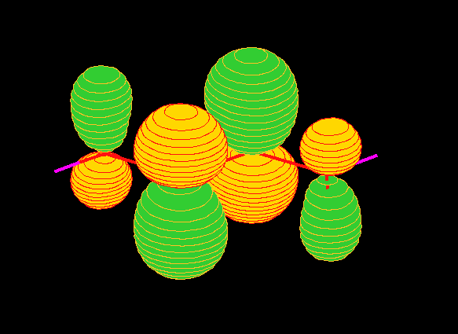
CNDO/S Implementation
Included Overlap Matrix (S ≠ I)
Modified the Fock Matrix Construction
Adjusted Energy Calculation
Adjusted Parameters
Added Damping for Better Convergence
Notes:
Included Overlap Matrix (S ≠ I)
CNDO/S explicitly accounts for overlap between atomic orbitals
This requires solving a generalized eigenvalue problem
Modified the Fock Matrix Construction
We altered diagonalization in fock matrix construction
Adjusted Energy Calculation
includes overlap when calculating electronic energy:
Parameters adjustment
For CNDO/S, we adjusted:
H Beta: Changes the strength of H–X
C Beta: Analogous effect on C–C and C–H coupling
Added Damping for Better Convergence
CNDO/S can be harder to converge than CNDO/2
Added damping to SCF iterations:

Slide 6
MINDO/3
Additional parameter info
U_{s/p}, g_{ss/pp/sp}
Wolfsberg-Helmholtz Factors
b_{AB} = ꞵ_{μ𝜈} / S_{μ𝜈}
Mulliken Orbitals
q_{μ} = ∑_{μ}(P_{μ𝜈}S_{μ𝜈})
Fock Off-Diagonal Element
F_{μ𝜈}​ = S_{μ𝜈}​(U_{μ}​ + U​_{𝜈}) b_{AB}​− p_{μ𝜈}​ γ_{AB} ​(R_{AB}​)
Individual Calcs for ½(I_{u} + A_{u}) term in core Hamiltonian
H_{μμ}​ = U_{μ}​ − (q_{μ}​− ½ ) γ_{AA​} − ∑​_{B≠A}(q_{B}​−Z_{B}​) γ_{AB}​
Notes:
Modified Intermediate Neglect of Differential Overlap expands upon CNDO by parameterizing directly to experimental heats of atomization and molecular geometries as opposed to the standard ab initio methods we have learned. After neglect of diatomic differential overlap, the remaining one and two center integrals are replaced by simple parametric functions and the parameters as seen above. Instead of using predetermined values for each atom and orbital, more values are calculated to directly fit the molecule they belong to and quantifiably account for the orbital overlaps. The U term are the one-center orbital energies for the s and p orbitals. Wolfsberg-Helmholtz factors encode the distance and one-center energies in one number so that the distance-relative energies are accounted for. Mulliken Orbitals summate the distance-relative densities by assigning electron density to each orbital based on the density matrix and the overlap. The Fock matrix is calculated to combine the resonance term and electrostatic correction, while the core Hamiltonian incorporates self-repulsion and inter-atomic charge terms.

Slide 7
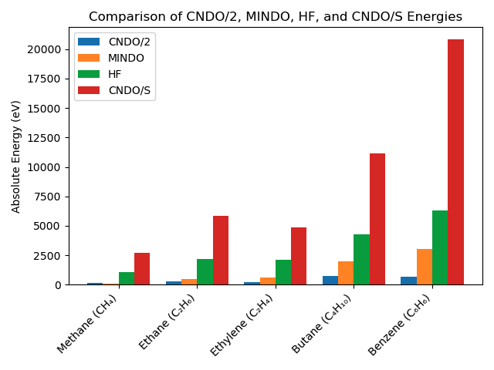
Results
Notes:
For our benchmark we used a Hartree Fock prediction in green. You can see the CNDOS model in red overshot this benchmark and was especially high for aromatic benzene. In contrast The MINDO model implementation was consistently undershooting the target Hartree fock values across the hydrocarbons. Both our implementations were closer to goal values than standard CNDO2.

Slide 8
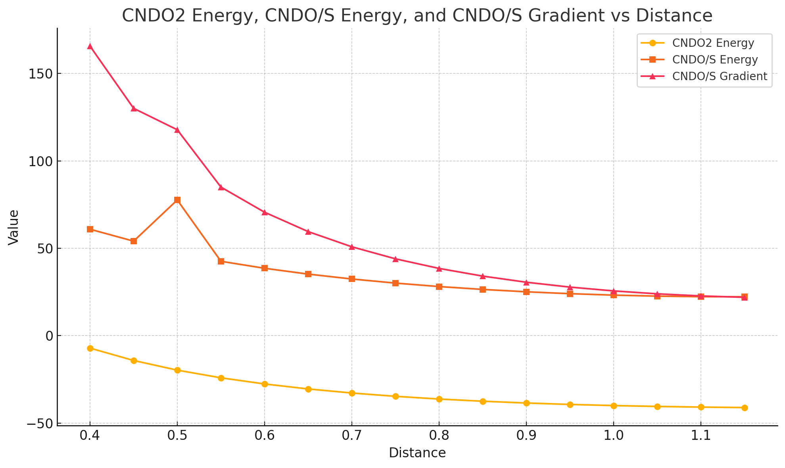
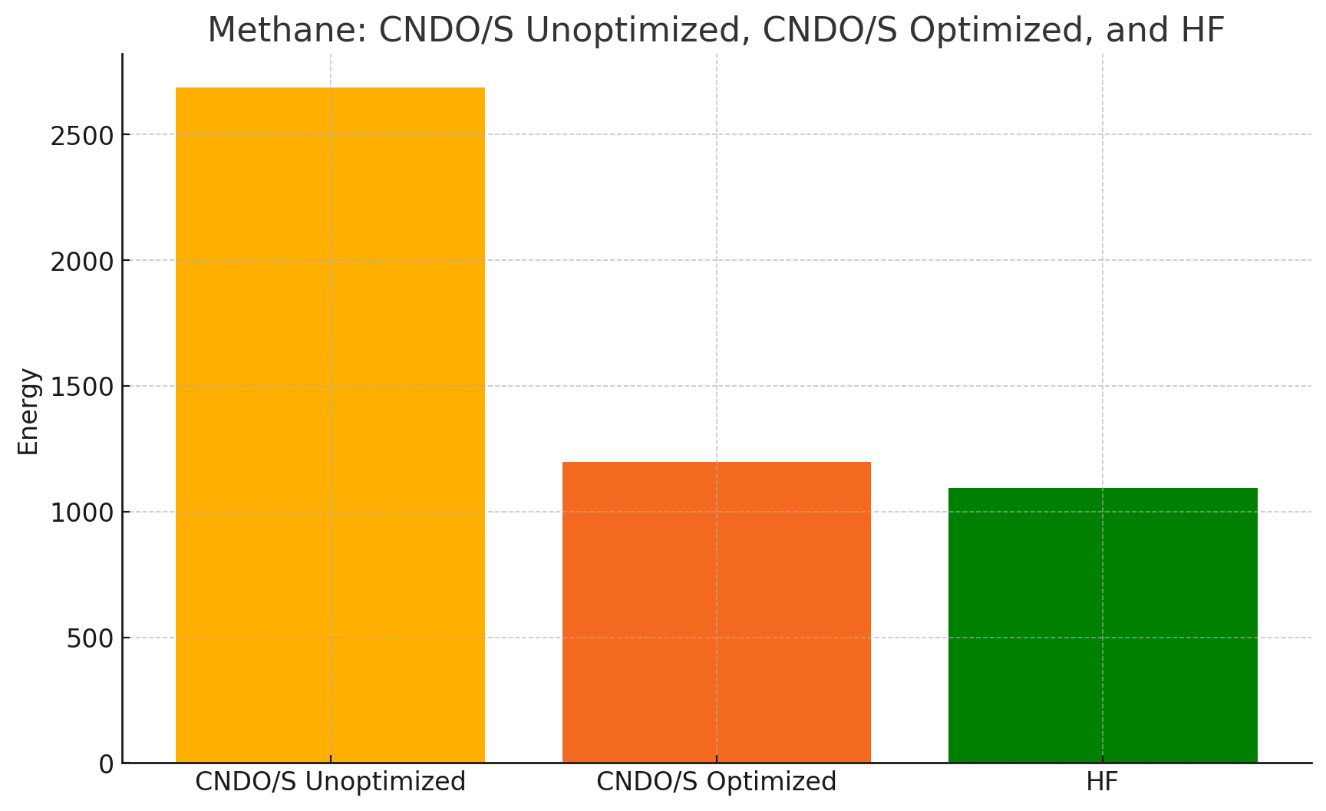
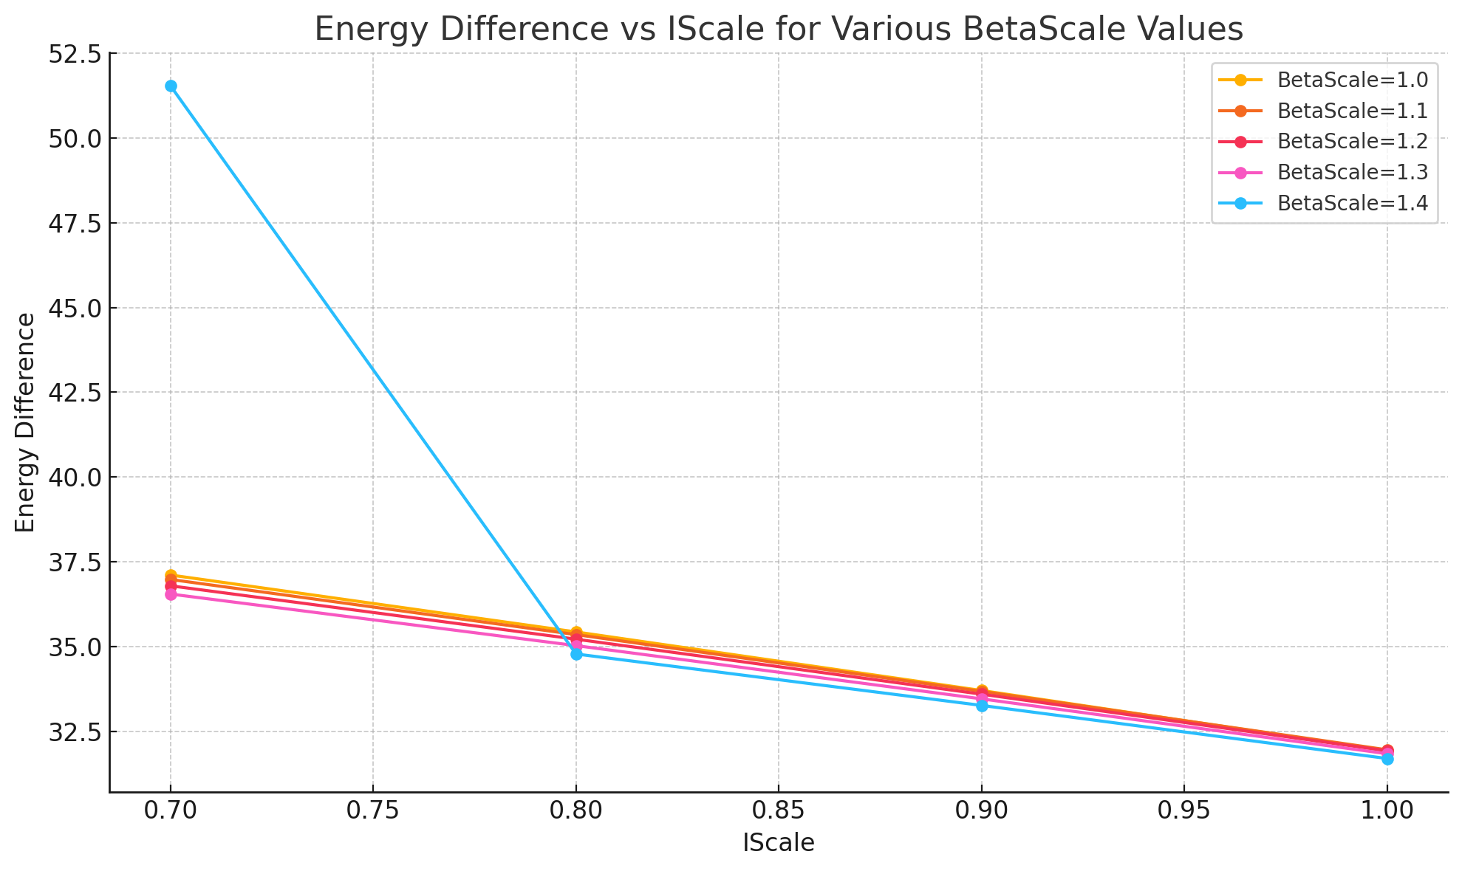
Results
Notes:
In the top left corner we investigate bond length distances effect on our CNDO/S energy and gradient and below that we looked into betascale’s correlation with energy for Diatomic Hydrogen.
Using this information we took the lowest most stable values and implemented them into our CNDOS model. You can see on the right we were able to improve the models gap between the goal of Hartree fock prediction in green and our CNDOS model with optimization.

Slide 9
Discussion
Use convergence‐boosting techniques—like DIIS, level shifting, or non-linear SCF—to reach stable solutions faster.
Build your optimization pipeline by starting with small hydrocarbons and then moving to larger ones, so each step refines the model.
Adjust key MINDO/3 parameters (e.g. Wolfsberg–Helmholtz factors, γ-terms) to tighten the agreement between computed and experimental energies.
Track and compare SCF iteration counts across methods to see which approaches converge most efficiently.
Investigate any outlier or incorrect energy values by systematically tracing through the calculation steps.

Slide 10
Thanks!

